Slide 1

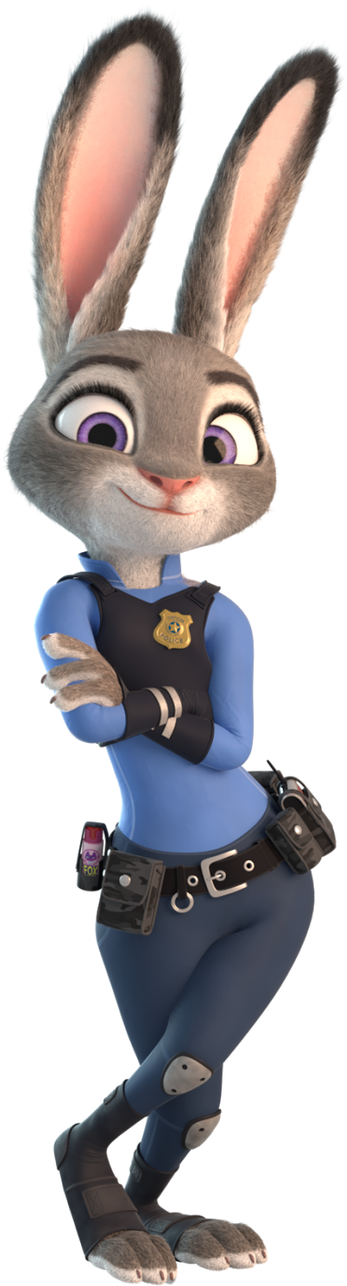
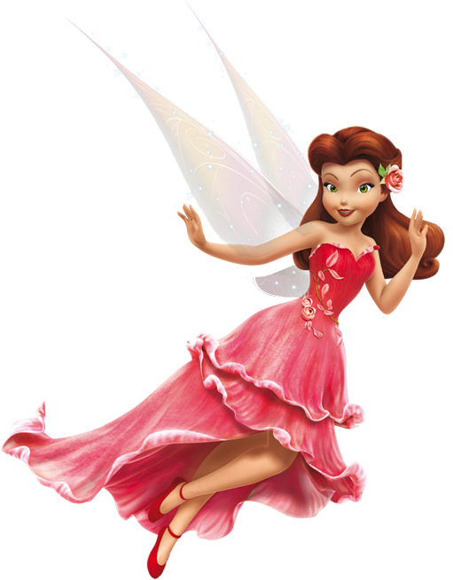
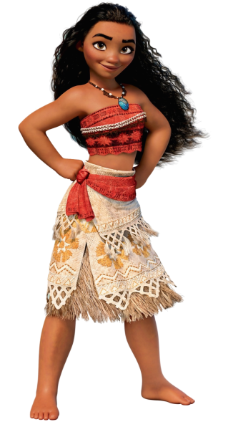
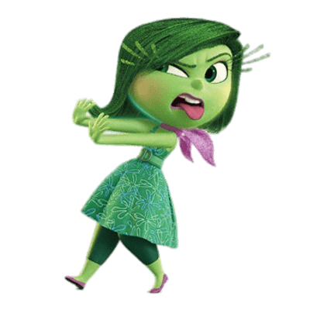

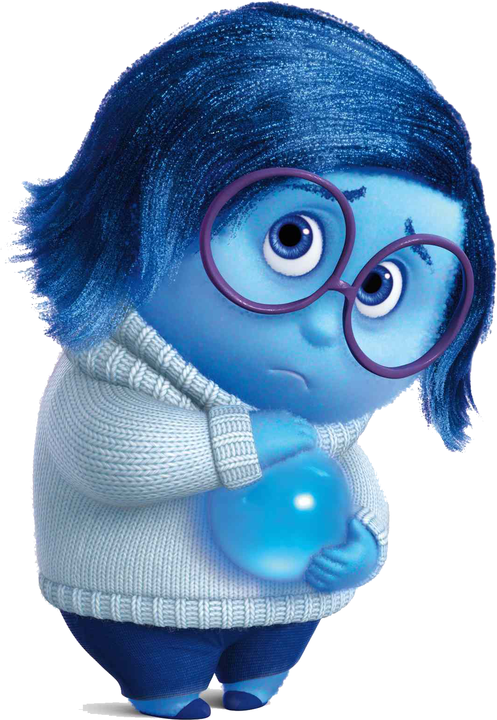
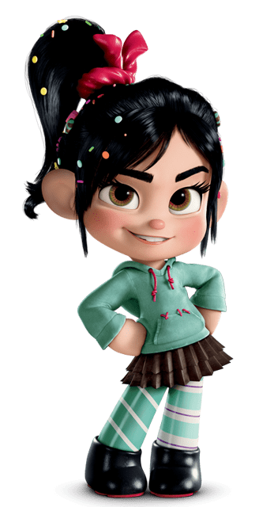
Characters
Menu
Search characteres…
Rosetta
Sadness
Disgust
Judy
Moana
Vanellope
Movie :
TinkerBell
Movie :
Inside Out
Movie :
Inside Out
Movie :
Zootopia
Movie :
Moana
Movie :
Wreck-It Ralph
Next
Prev

Slide 2
Search characteres…
Characters
Menu
Rosetta
Sadness
Disgust
Judy
Moana
Vanellope
Movie :
TinkerBell
Movie :
Inside Out
Movie :
Inside Out
Movie :
Zootopia
Movie :
Moana
Movie :
Wreck-It Ralph
Prev
Next

Slide 3
Search characteres…
Characters
Menu
Rosetta
Sadness
Disgust
Judy
Moana
Vanellope
Movie :
TinkerBell
Movie :
Inside Out
Movie :
Inside Out
Movie :
Zootopia
Movie :
Moana
Movie :
Wreck-It Ralph
Prev
Next

Slide 4


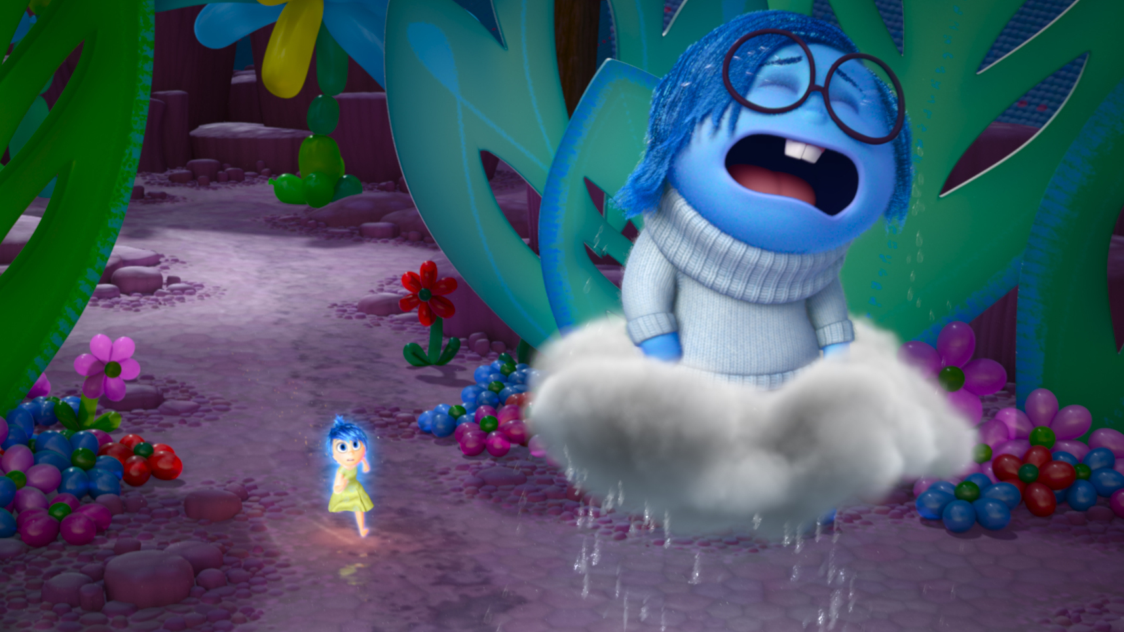
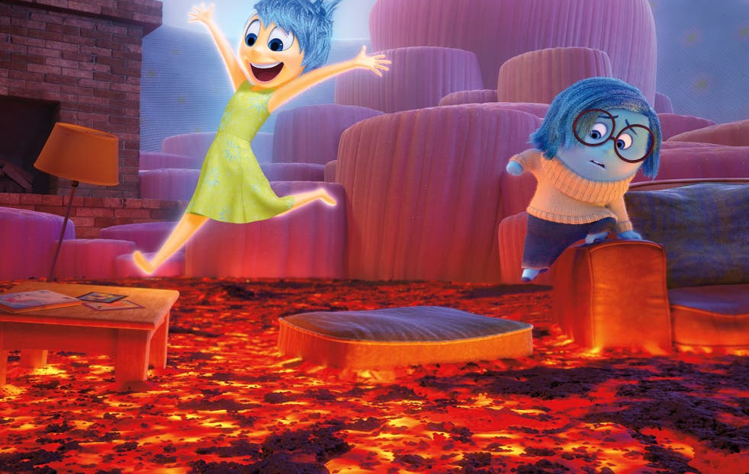
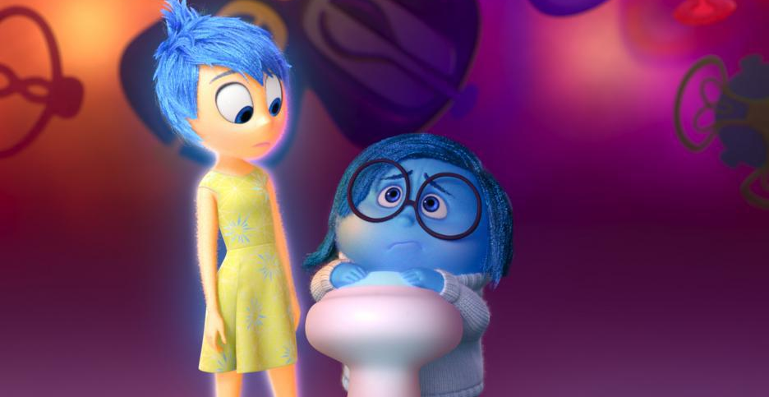
Sadness
Disgust
Search characteres…
Characters
Menu
Close
Rosetta
Sadness
Disgust
Judy
Moana
Vanellope
Movie :
TinkerBell
Movie :
Inside Out
Movie :
Inside Out
Movie :
Zootopia
Movie :
Moana
Movie :
Wreck-It Ralph
Prev
Next
Sadness is literally the very definition and being of sorrow and gloom. She was hardly ever used because Joy is the dominant emotion and didn't want Riley to ever be sad. Because of this, Joy treated Sadness poorly.
Clips

Slide 5
Search characteres…
Characters
Menu
Close
Sadness
Sadness
Movie :
Inside Out
Sadness is literally the very definition and being of sorrow and gloom. She was hardly ever used because Joy is the dominant emotion and didn't want Riley to ever be sad. Because of this, Joy treated Sadness poorly.
Rosetta
Disgust
Judy
Moana
Vanellope
TinkerBell
Disgust
Inside Out
Zootopia
Moana
Wreck-It Ralph
Movie :
Movie :
Movie :
Movie :
Movie :
Clips
Prev
Next

Slide 6
Search characteres…
Characters
Menu
Rosetta
Sadness
Disgust
Judy
Moana
Vanellope
Movie :
TinkerBell
Movie :
Inside Out
Movie :
Inside Out
Movie :
Zootopia
Movie :
Moana
Movie :
Wreck-It Ralph
Prev
Next
Sadness
Disgust

Slide 7

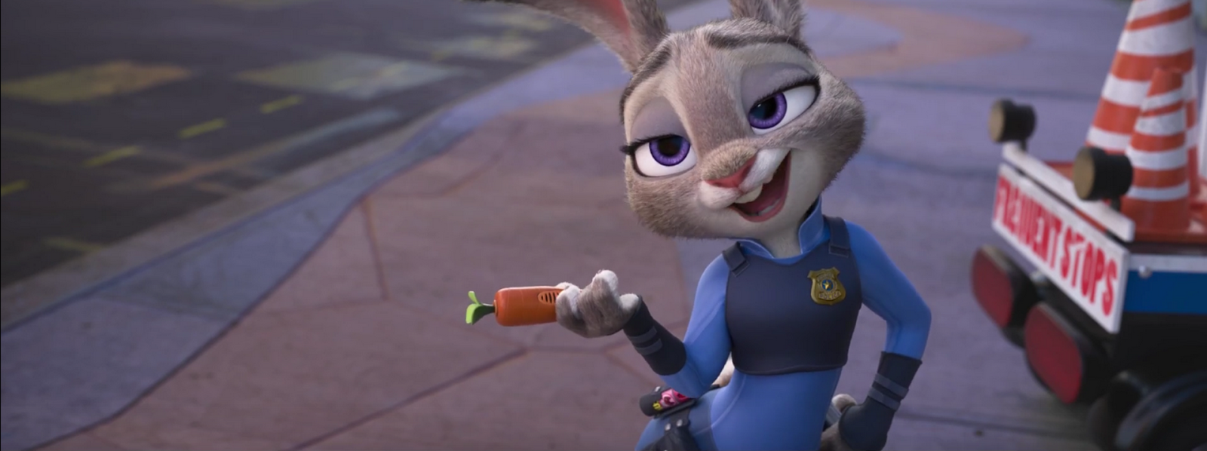
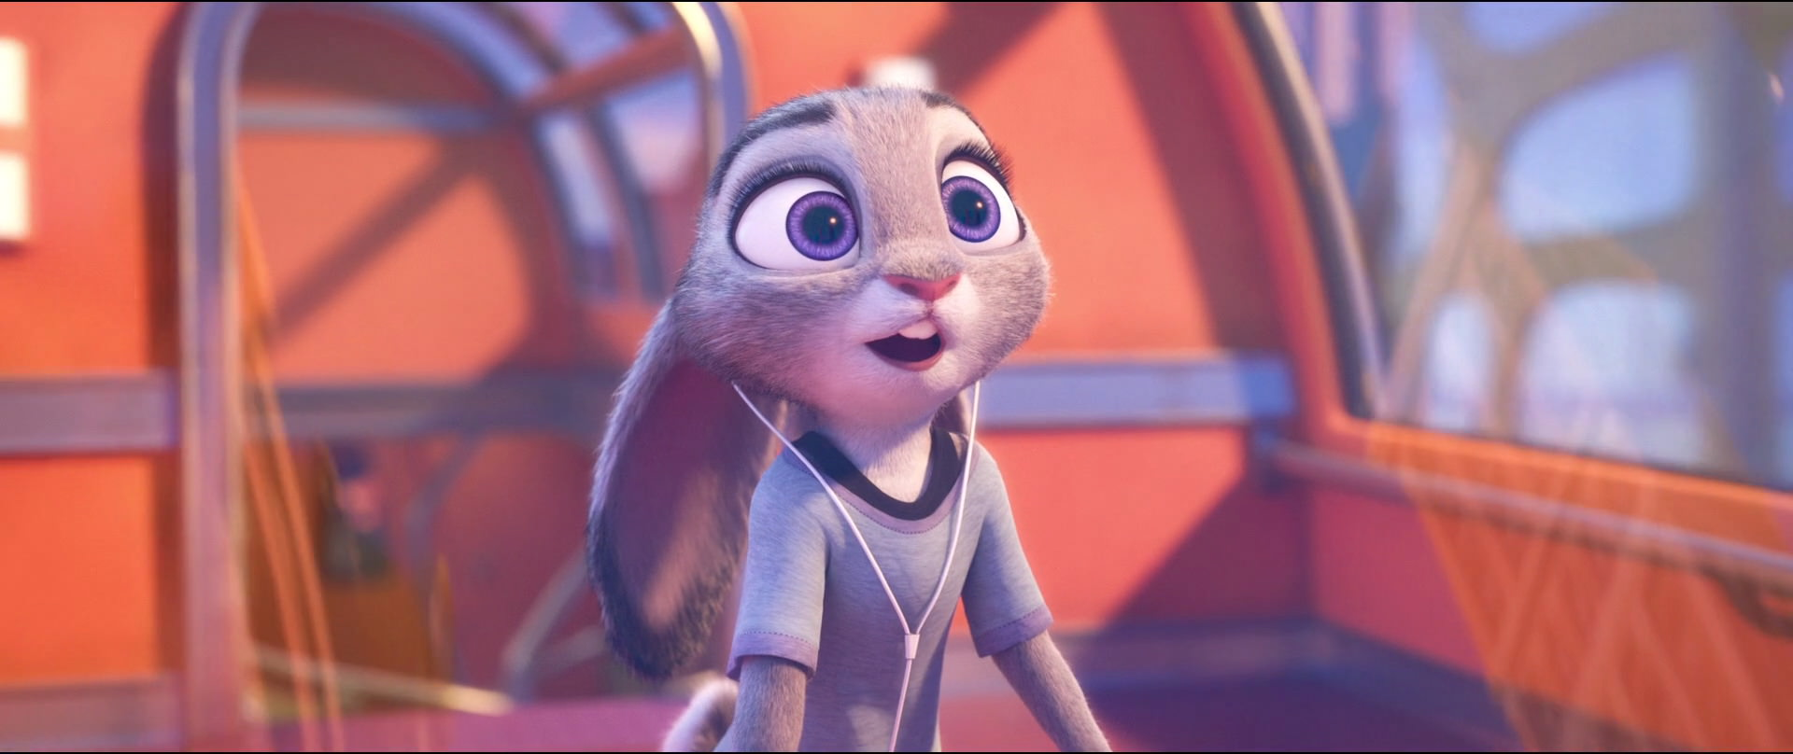
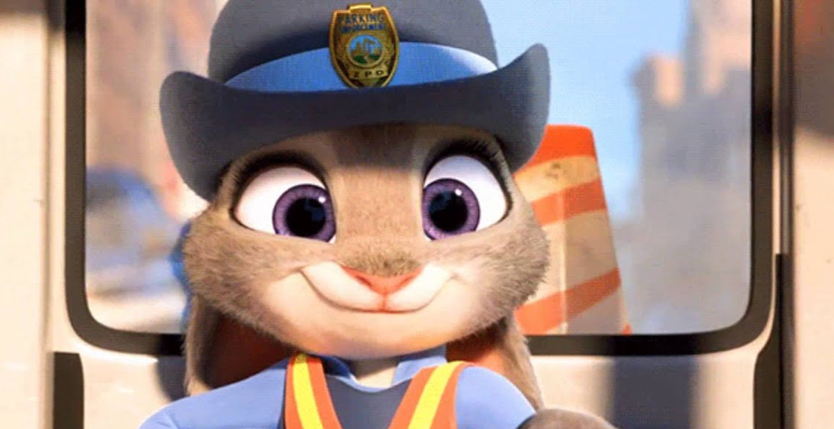
Search characteres…
Characters
Menu
Close
Rosetta
Sadness
Disgust
Judy
Moana
Vanellope
Movie :
TinkerBell
Movie :
Inside Out
Movie :
Inside Out
Movie :
Zootopia
Movie :
Moana
Movie :
Wreck-It Ralph
Prev
Next
“In Hopps' animation, we tried to celebrate both her rabbitness and her female nature. She's a tough bunny, but she's still feminine. She's sweet, but she's not weak. And when she's on high alert, her natural rabbit instincts take over - ears and nose twitching, foot thumping.”
Judy
Clips
Moana

Slide 8
Search characteres…
Characters
Menu
Close
Judy
Judy
Zootopia
Movie :
“In Hopps' animation, we tried to celebrate both her rabbitness and her female nature. She's a tough bunny, but she's still feminine. She's sweet, but she's not weak. And when she's on high alert, her natural rabbit instincts take over - ears and nose twitching, foot thumping.”
Rosetta
Sadness
Disgust
Moana
Vanellope
TinkerBell
Inside Out
Inside Out
Moana
Moana
Wreck-It Ralph
Movie :
Movie :
Movie :
Movie :
Movie :
Clips
Prev
Next

Slide 9
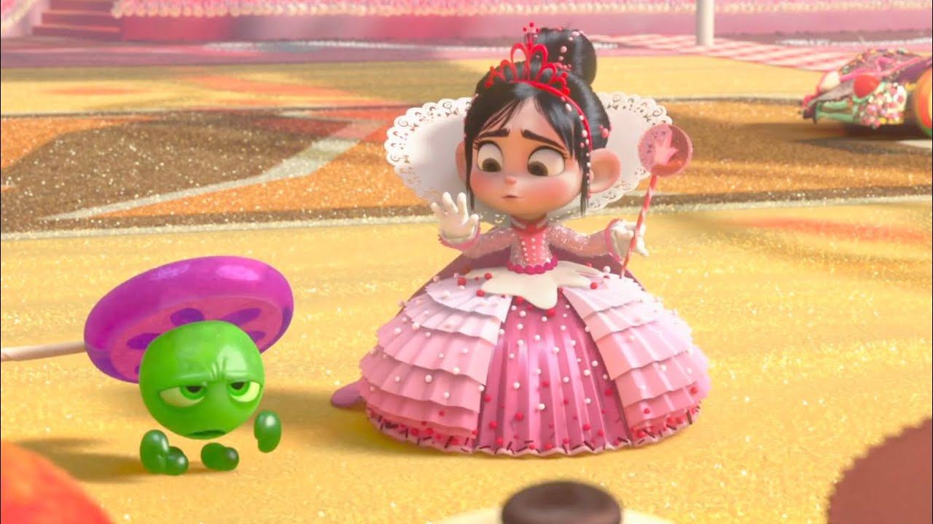
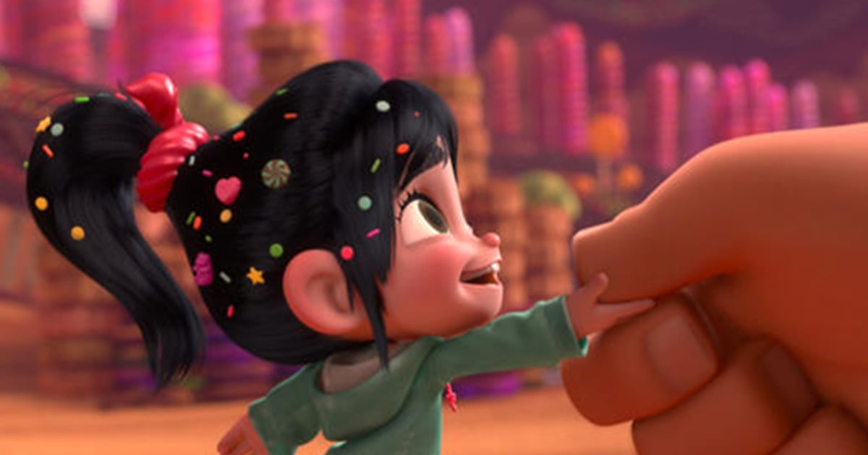
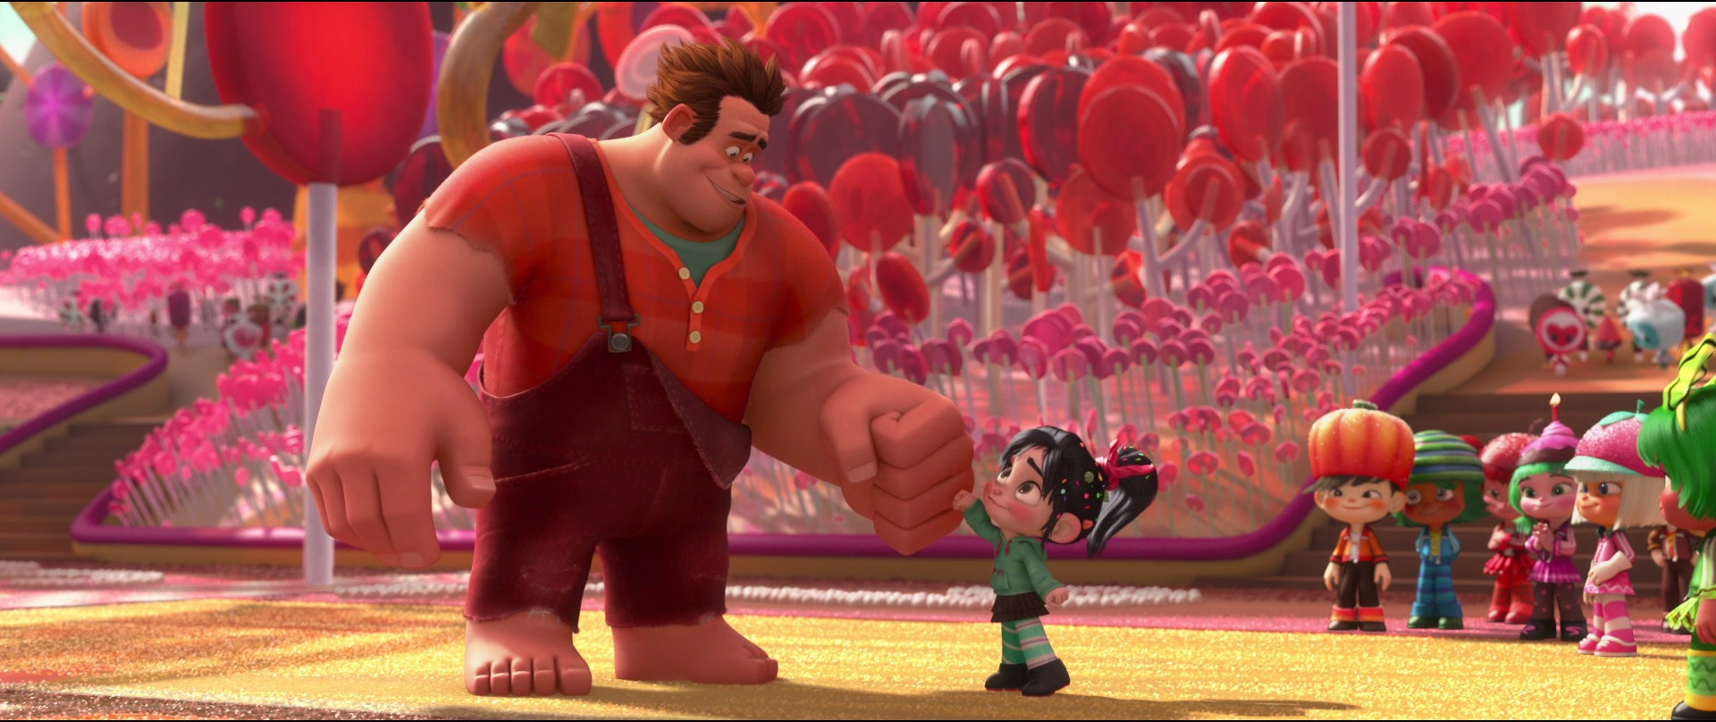
Search characteres…
Characters
Menu
Rosetta
Sadness
Disgust
Judy
Moana
Vanellope
Movie :
TinkerBell
Movie :
Inside Out
Movie :
Inside Out
Movie :
Zootopia
Movie :
Moana
Movie :
Wreck-It Ralph
Prev
Next
Judy
Venellope
Vanellope von Schweetz is the deuteragonist of Disney's 2012 animated feature film, Wreck-It Ralph and its 2018 sequel. She is a young, sharp-tongued racer that originates from the candy-themed racing game Sugar Rush. Due to being a "glitch", Vanellope was forbidden to race by order of King Candy.
Clips
Moana
Rosetta

Slide 10
Search characteres…
Characters
Menu
Close
Vanellope
Venellope
Movie :
Wreck-It Ralph
Vanellope von Schweetz is the deuteragonist of Disney's 2012 animated feature film, Wreck-It Ralph and its 2018 sequel. She is a young, sharp-tongued racer that originates from the candy-themed racing game Sugar Rush. Due to being a "glitch", Vanellope was forbidden to race by order of King Candy.
Rosetta
Sadness
Disgust
Judy
Moana
TinkerBell
Inside Out
Inside Out
Zootopia
Moana
Rosetta
Movie :
Movie :
Movie :
Movie :
Movie :
Clips
Personality
In line with her programmed age, Vanellope is extremely energetic, talkative, and childish. When excited, she zestfully zips and bounces around while repeatedly exclaiming the reasoning behind her excitement, much like a normal child.
Judy
Physical appearance
Vanellope is a 12-year-old girl with a small stature. She has long, raven-black hair with candy sprinkled over it in a high ponytail. Her design was influenced by Japanese/anime artwork, notably the style of Chibi, with large, hazel eyes. She carries a slender body, has a noticeable overbite, large, round ears, and a small, pink button nose.
Moana

Slide 11


Movie :
Wreck-It Ralph
Vanellope von Schweetz is the deuteragonist of Disney's 2012 animated feature film, Wreck-It Ralph and its 2018 sequel. She is a young, sharp-tongued racer that originates from the candy-themed racing game Sugar Rush. Due to being a "glitch", Vanellope was forbidden to race by order of King Candy.
Characters
Menu
Vanellope
Clips
Venellope
Personality
In line with her programmed age, Vanellope is extremely energetic, talkative, and childish. When excited, she zestfully zips and bounces around while repeatedly exclaiming the reasoning behind her excitement, much like a normal child.
Physical appearance
Rosetta
Vanellope is a 12-year-old girl with a small stature. She has long, raven-black hair with candy sprinkled over it in a high ponytail. Her design was influenced by Japanese/anime artwork, notably the style of Chibi, with large, hazel eyes. She carries a slender body, has a noticeable overbite, large, round ears, and a small, pink button nose.
Prev
Next

